Slide 1
Büyük Veri
Machine Learning

Slide 2
What is Data Analytic?
Data analytics, although a general term, generally deals with the analysis of data for business applications.
More broadly, it is sometimes referred to as data science, data analysis, or data mining.
However, data analytics offers frameworks for data storage and retrieval, machine learning, streaming data analytics, and big data analytics.

Slide 3
Data Analytics
Data analytics can be defined as examining data through various algorithms and applications and making inferences about the information it contains in the light of these examinations
The "big data" that emerged in the century we live in, that is, data analytics used in the analysis of big data, is actually a field that helps many different sectors.
Technologies or campaigns developed using data analytics have become the developments and trends that touch our lives the most.

Slide 4
Types of Data Analytics
Descriptive Analytics
Diagnostic Analytics
Predictive Analytics
Prescriptive Analytics

Slide 5
Descriptive Analytics
Descriptive analytics, “what happened?” answers the question.
Descriptive analytics combine raw data from multiple data sources to provide valuable historical insights.
However, these findings indicate that something is wrong or right without explaining why.

Slide 6
Diagnostic Analytics
Diagnostic analytics is the process of examining data to understand the cause, event, or why something happened.
Techniques such as drill-down, data exploration, data mining, and correlations are often used.
The main question answered in this data type is “why did it happen?”

Slide 7
Predictive Analytics
Predictive analytics is where you begin by predicting “potential future outcomes” and turning the results of your descriptive and diagnostic analyzes into actionable concepts for decision making.
Predictive analytics, when predicting future results, does not make a judgment about whether the situation is likely to occur, which includes the answer to a question such as "Will a new competitor join the market".
Instead, it allows us to get a result such as “Our sales may decrease by 20% in 2020 based on data on a competitor joining the market”.

Slide 8
Prescriptive Analytics
Predictive analytics builds on predictive analytics, helping to identify recommended (predicted) actions based on desired potential (predicted) outcomes.
Predictive analytics help organizations achieve their business goals.
Predictive analytics models continually “learn” through feedback mechanisms to continually analyze action and event relationships and suggest the most appropriate solution.

Slide 9
Data Analytics Usage Areas
1. Transportation
2. Logistics and Delivery
3. Web search or internet web results
4. Manufacturing
5. Security
6. Education
7. Health

Slide 10
Data Analysis Methods
In data science, there are many ways to analyze data.
Data analytics consists of:
1. Data collection (data ingestion)
2. Data cleaning;
3. Visualization and Exploratory Analysis;
4. Feature Extraction and Selection;
5. Modeling;
6. Evaluation;
7. Inference

Slide 11
Data Collection
Data comes to the analyst in many forms, not all of them in a neat format that is easy to handle.
It is often necessary to read system logs (in various formats), extract data from pdfs and web pages, extract information from package headers and package payloads.
Source code and binaries are analyzed, unformatted text is processed, network topologies are analyzed, resulting in a rather long list of data types and data sources.

Slide 12
Data Processing and Cleaning
With data cleaning, erroneous data is eliminated.
However, bad data obtained due to transcription errors or sensor misconfiguration needs to be removed, or at least identified and labeled as bad.
As a rule, it is not recommended to permanently remove "bad" data, although it can be temporarily removed for a particular calculation.

Slide 13
Data Visualization and Exploratory analysis
Data visualization is included in many business intelligence tools and is essential for advanced analytics.
It helps people to understand all the information or data produced today.
With data visualization, information is presented, for example, in a pie or bar chart, or some other form of visual presentation.

Slide 14
Feature Extraction and Selection
Feature Selection is the name given to the process of evaluating features piece by piece in order to determine which features have an impact on the result and how much.
It is tried to reduce the high-dimensional data to low-dimensionality and to obtain the same or higher accuracy rate.

Slide 15
Modelling
There are five key aspects of data analytics modeling:
1. Features: A model suitable for the data is determined. For example, one may decide to use Gaussian mixing models to model their data.
2.Selection: Choose from the model set. In the case of the mixture model, this would be to choose the number of components in the mixture and perhaps the shapes of the mixture covariances or other constraints.
3. Fitting: Fit the parameters of the model to the data. Means, covariances and mixing ratios need to be determined for the mixing situation.
4. Evaluation: Determine whether the model fits the data.
Conclusion 5: Make the appropriate decision using the results from the above steps.

Slide 16
Evaluation
There are many metrics that can be used in the Machine Learning field.
MSE, RMSE, MAE, MAPE and Other Metrics
Cross Validation
Measuring the Quality of Forecasts

Slide 17
Artificial Intelligence and Machine Learning

Slide 18
Artificial Intelligence
While intelligence is the capacity to learn and solve problems, artificial intelligence is some of the qualities that machines and robots have their own intelligence and computer science aims to create.
Examples include the ability to solve problems, the ability to act rationally, and the ability to act like people.

Slide 19
Machine Learning
Machine learning is a branch of artificial intelligence (AI) and computer science that gradually increases its accuracy by focusing on the use of data and algorithms to mimic the way humans learn.
It is known that the term "machine learning" was first used by an IBM insider, Arthur Samuel, in his research on the game of checkers (PDF, 481 KB) (link resides outside IBM).
Expert checkers player Robert Nealey played the game on an IBM 7094 computer in 1962 and lost against the computer.
Considering what's possible today, this achievement may seem almost trivial; however, it is seen as an important turning point in the field of artificial intelligence.

Slide 20
Machine Learning
The learning system of a machine learning algorithm is divided into three main parts;
1. A Decision Process: Generally, machine learning algorithms are used to make a prediction or classification. Based on some input data, which may or may not be labeled, your algorithm will generate a prediction about a pattern in the data.
2. An Error Function: An error function is used to evaluate the prediction of the model.
If known examples are available, an error function can run a benchmark to evaluate the model's accuracy.
3. A Model Optimization Process: If the model better fits the data points in the training set, then the weights are adjusted to reduce the discrepancy between the known sample and the model prediction. The algorithm autonomously updates the equivalent weights when a threshold of accuracy is reached, repeating this evaluation and optimizing the process.

Slide 21
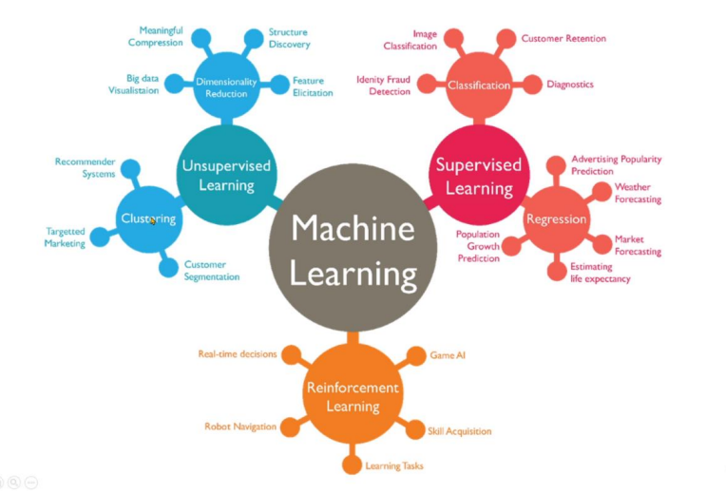
Machine Learning Types

Slide 22
Supervised Machine Learning
Supervised machine learning, also known as supervised machine learning, is defined as using labeled datasets to classify data and train algorithms that accurately predict results.
Among the methods used in supervised learning; methods such as neural networks, naïve Bayes, linear regression, logistic regression, random forest, support vector machine (SVM).

Slide 23
Unsupervised Machine Learning
Unsupervised learning, also known as unsupervised machine learning, uses machine learning algorithms to analyze and cluster unlabeled datasets.
It is also used to reduce the number of features in a model through dimensionality reduction; primary component analysis (PCA) and singular value decomposition (SVD) are two common approaches to this.
Some of the other algorithms used in unsupervised learning are neural networks, k-means set, probabilistic clustering methods etc. is in the form.

Slide 24
Semi-Supervised Learning
Semi-supervised learning offers a middle ground between the supervised and unsupervised type.
During training, it uses a smaller, labeled dataset to drive classification and feature separation from a larger, unlabeled dataset.
Semi-supervised learning can solve the problem of not having enough labeled data (or not being able to label enough data) to train a supervised learning algorithm.

Slide 25
Reinforcement machine learning
Reinforcement machine learning is a behavioral machine learning model that is similar to supervised learning, but in which the algorithm is not trained using simple data.
This model learns by trial and error. The set of successful results is reinforced to develop the best recommendation or principle for a particular problem.

Slide 26
Machine Learning Algorithms
1- Regression (Forecast)
2-Classification
3- Clustering
4- Association
5- Anomaly (Deviation) Detection
6- Row Pattern Mining
7- Dimensional Reduction (Dimensionality reduction)
8- Finding trends or directions from suggestions

Slide 27
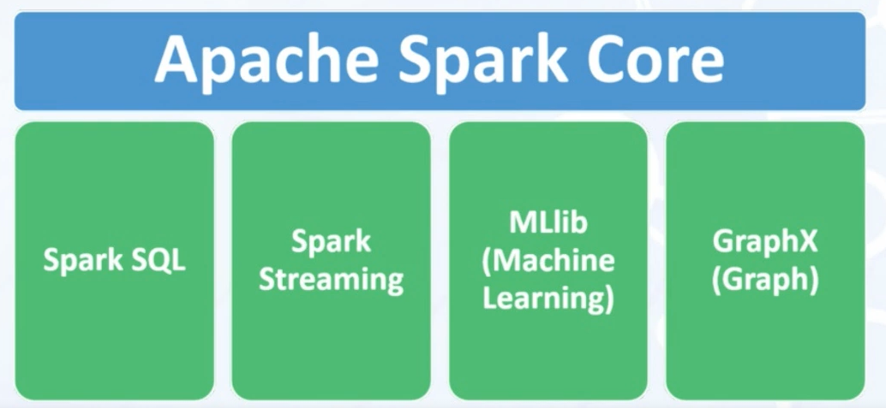
Apache Spark MLlib
It is the library that contains machine learning algorithms in Apache spark.

Slide 28
Apache Spark MLlib
Why should we use MLlib when developing ML applications?
It is a distributed and scalable ML library.
It is developed using Java, Scala, Phyton, R.
It is integrated after 0.8 version of Apache Spark. (2013)

Slide 29
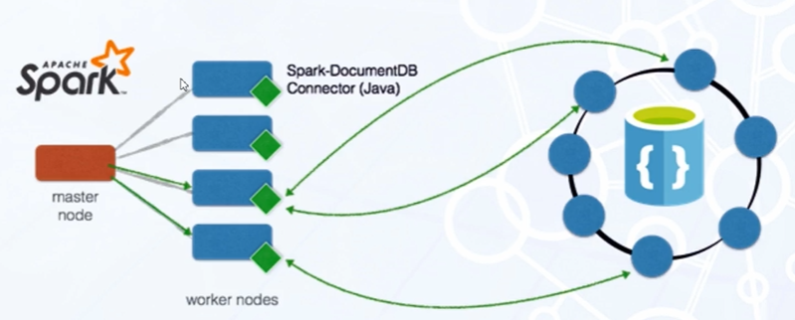
Apache Spark MLlib

Slide 30
Apache Spark MLlib
Why Mllib?
ML Algorithms
Simplicity
Scalability

Slide 31
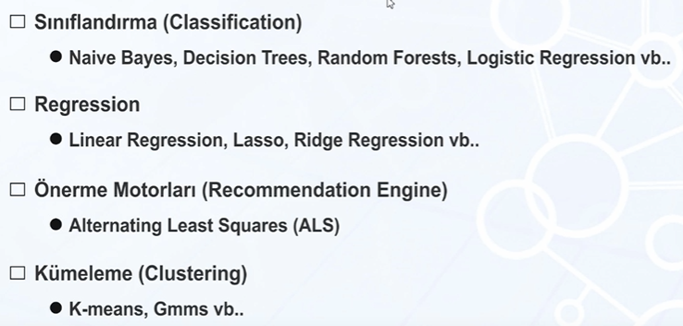
Apache Spark Mllib Algorithms

Slide 32
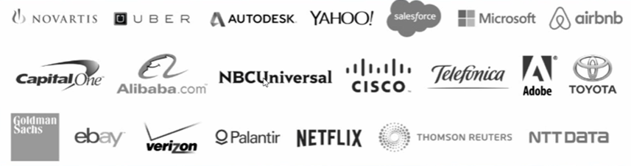
Well-known companies using Spark Apache Spark

Slide 33


Mllib alternatives
 | Works on RAM Faster than Mahout Continues to be developed
Works on disk
Very slow
Old library

Slide 34
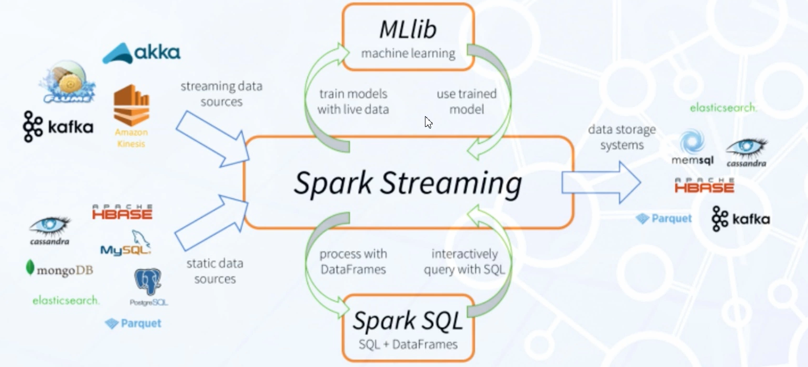
MLlib

Slide 35
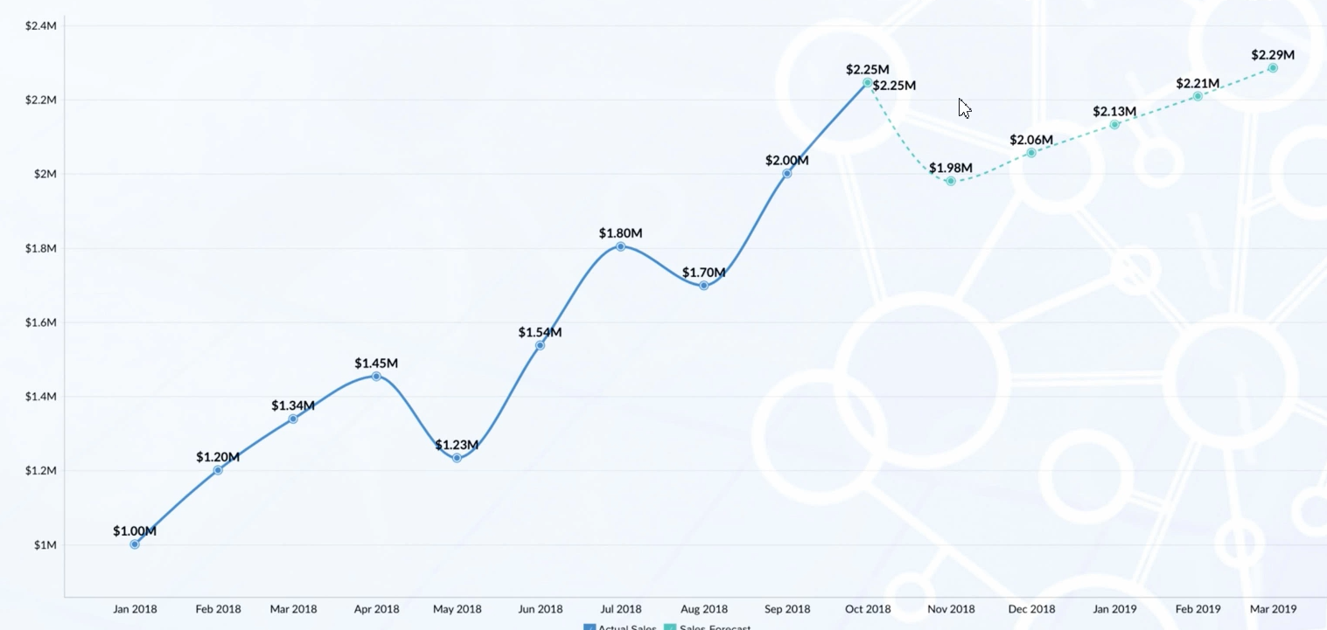
Prediction vs Forecasting

Slide 36
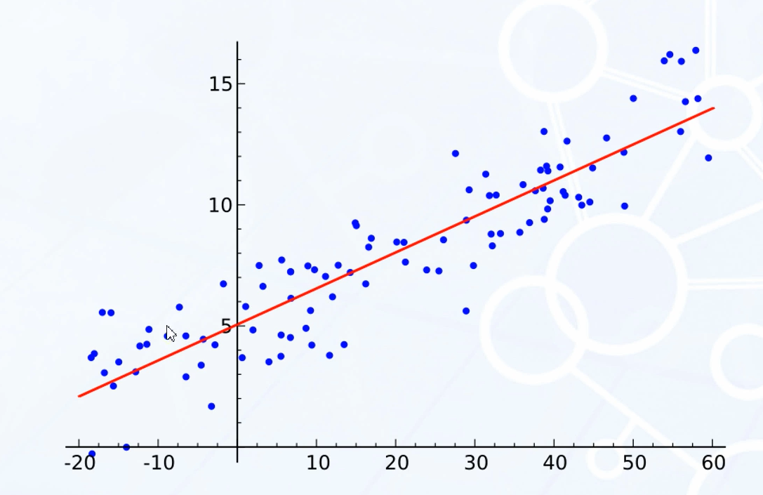
Linear Regression

Slide 37
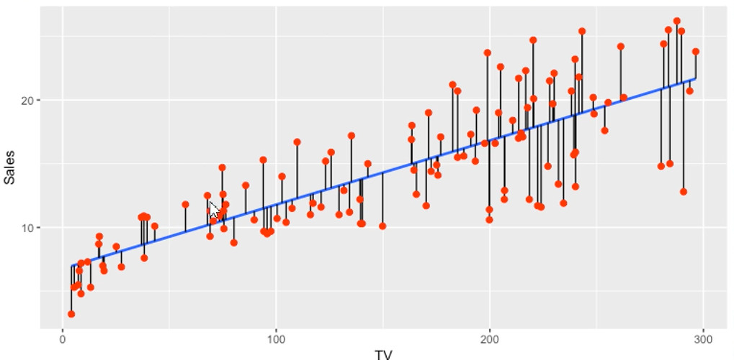
Linear Regression

Slide 38
